Slide 1
cGANs for Creating Synthetic Motion Capture Data
Reproduction of Bicer et al. (2024)
Deep Learning in Multimedia
Supervisor: Robert Metzger
Student: Evgeniya Ryasnova

Slide 2
Motivation
Motion capture data are useful for: biomechanics, rehabilitation, sports science, robotics, animation/VR, ergonomics. (Halilaj et al., 2018; Bicer et al., 2024)
Main limitations of real mocap data:
01
Resource-intensive collection
02
Limited dataset size and diversity
Equipment
+ lab
Specialized equipment, controlled lab setup, and technical expertise are required.
Small
datasets
Small datasets reduce the generalization of deep learning models to new subjects and movement patterns.
03
Limited realism of simple augmentation
04
Privacy and sharing constraints
Realistic
variation
Numerical augmentation can increase dataset size, but may not capture natural gait variability.
Privacy
+ sharing
Human movement data can raise privacy concerns and may be difficult to share openly.

Slide 3
Motivation
Solution
Generative models can create realistic, shareable datasets while preserving key gait and subject characteristics. (Bicer et al., 2022; Bicer et al., 2024)

Slide 4
Guiding Research Question for This Reproduction
Can cGANs generate realistic and condition-controlled synthetic mocap data, and can the original study’s main results be reproduced?

Slide 5
Paper Focus
Generative adversarial networks to create synthetic motion capture datasets including subject and gait characteristics (Bicer et al., 2024)
Original paper
Our reproduction
Develop conditional GAN models that generate synthetic walking mocap data based on subject and gait characteristics. (Bicer et al., 2024)
Run the released code in Colab and reproduce the main training, evaluation, and visualization results.

Slide 6
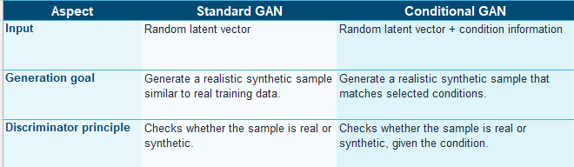
Theoretical Framework From GANs to Conditional GANs

Slide 7
Theoretical Framework cGAN Architecture Used in the Paper
The paper adapts the GAN framework into a conditional architecture for synthetic walking mocap generation. (Bicer et al., 2024)
Generator as an autoencoder: The generator consists of an encoder and a decoder. The encoder compresses real mocap data into a latent vector, and the decoder reconstructs mocap data from this latent representation.
Condition information is added to the latent vector: Subject and gait characteristics are concatenated with the latent representation before reconstruction.
The discriminator works in latent space: It learns to distinguish encoded latent vectors from random latent vectors, both combined with condition information.
After training, the decoder becomes the generator: The decoder can generate new synthetic mocap trials from a random latent vector plus selected conditions.
This allows controlled synthetic data generation: For example, the model can generate walking data for a chosen walking speed, body mass, or combination of subject characteristics.

Slide 8
Dataset and Conditions
Dataset
Extracted features
Public walking mocap dataset (Schreiber & Moissenet, 2019; Bicer et al., 2024)
Training:
733 trials, 46 subjects 21 females / 25 males walking speed: 0.18–2.04 m/s
Test:
47 trials, 3 unseen subjects selected as extreme cases up to 2.36 m/s
Marker trajectories
Pelvis and right-leg kinematics
Right-leg 3D ground reaction forces
Time-normalized gait cycles: 0–100%
All gait cycles were normalized to make trials directly comparable.
Conditions:
age
sex
mass
leg length
walking speed
Sources: Schreiber & Moissenet (2019); Bicer et al. (2024)

Slide 9
Reproduction Workflow From Original Repository to Reproduced Results Pipeline
1
Environment setup
Python, PyTorch, CUDA/GPU check
2
Repository preparation
Clone repo and set working directory
3
Dependencies
Install spm1d, ezc3d, statsmodels
4
Test training
10-epoch WS-cGAN pipeline check
5
Full training
WS-cGAN, 3000 epochs, walking speed
6
Evaluation
Run scripts and inspect figures/results
What was reproduced
• Training dataset comparison
• Dimensionless walking speed analysis
• Literature findings replication
• Subject-specific prediction for unseen test subjects
• Dynamic consistency analysis
Colab compatibility fixes Updated missing imports, disabled problematic LaTeX rendering, and adjusted paths/output handling.
train_cgan( label_col_contd=['walking_speed'], n_epochs=3000, model_name='wscgan' )
Takeaway: The original workflow was reproduced as an end-to-end pipeline: setup - training - compatibility fixes - evaluation - figures and results.

Slide 10
Reproduced Results
Block 1
Block 2
Block 3
1
Training dataset characteristics
2
Dimensionless walking speed
3
Literature findings
Do synthetic trials match real training data?
Are speed-related gait patterns preserved?
Can synthetic cohorts reproduce previous studies?
Block 4
Block 5
4
Subject-specific prediction
5
Dynamic consistency
How well does the model work on unseen subjects?
Are generated trials biomechanically plausible?

Slide 11
Reproduced Results I Training Dataset Characteristics
Objective: Test whether synthetic trials remain close to the experimental training dataset. (Bicer et al., 2024; our reproduction notebook)
Evaluation method: Synthetic and experimental waveforms were compared using 1D statistical analysis across the gait cycle.
Entire training dataset: All models produced reasonably similar synthetic gait data. The lowest average difference was observed for the Sex/sex-conditioned cGAN: 2.4% of the gait cycle.
Multi-cGAN performance: The Multi-cGAN also showed strong agreement with the experimental dataset: 2.8% average difference across IK and GRF.
Constrained subset: For a restricted range of subject/gait conditions, the Multi-cGAN performed best: 7.0% average difference.
Interpretation: Single-condition models can reproduce broad dataset characteristics, while Multi-cGAN becomes especially useful when several conditions must be controlled together.

Slide 12
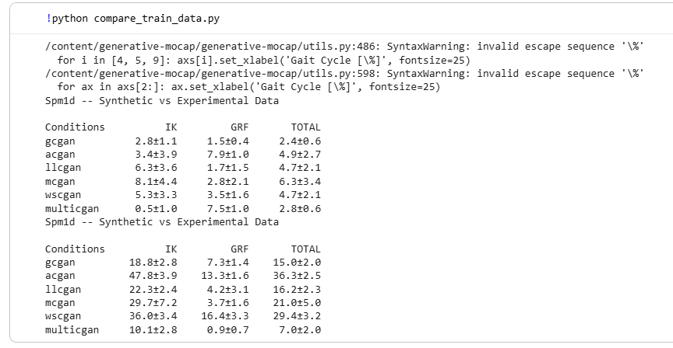
Reproduced Results I Training Dataset Characteristics
Takeaway: The reproduced results confirm that the cGAN models can generate synthetic walking trials that are statistically close to real mocap data. (Bicer et al., 2024; our reproduction notebook)

Slide 13
Reproduced Results II Dimensionless Walking Speed Analysis
Objective: To evaluate whether Multi-cGAN can reproduce gait patterns across different normalized walking-speed groups. (Bicer et al., 2024; our reproduction notebook)
Why this analysis matters: Walking speed strongly affects gait kinematics and ground reaction forces.
Analysis approach: Experimental and synthetic trials were grouped by dimensionless walking speed, and their average gait trajectories were compared.
Reproduced kinematics results: Hip, knee, and ankle trajectories showed very small errors across speed groups: approximately 0.3–1.2° RMSE in our reproduced outputs.
Reproduced GRF results: Vertical ground reaction force showed very small differences: approximately 0.01–0.02 BW RMSE.
Correlation: The reproduced outputs showed very high agreement between experimental and synthetic curves: r ≈ 1.0 across the reported variables.

Slide 14
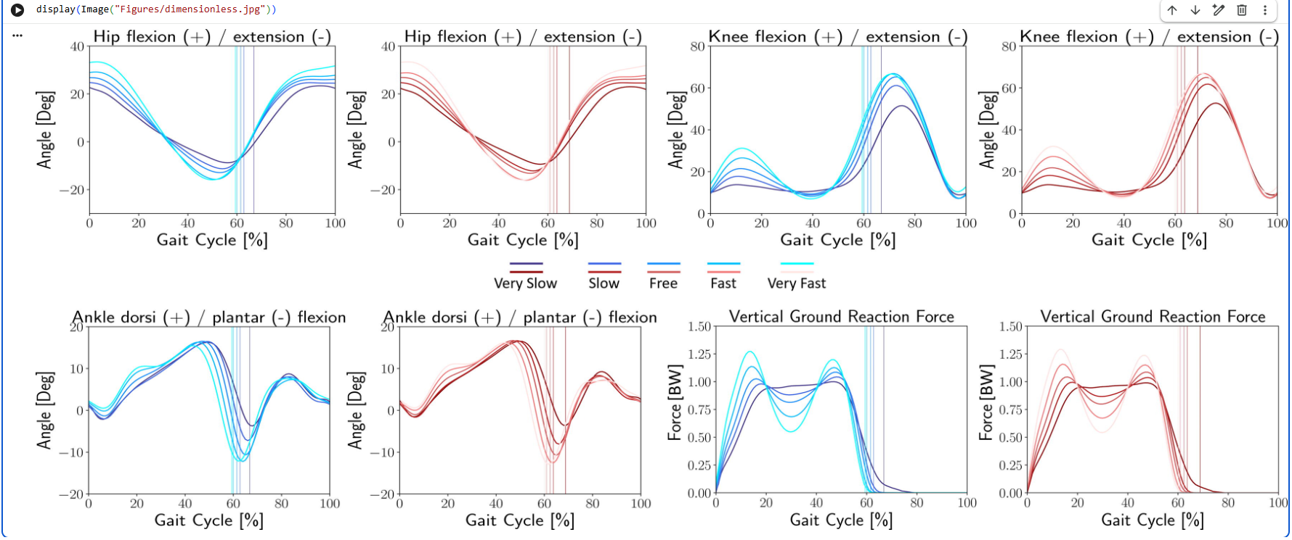
Reproduced Results II Dimensionless Walking Speed Analysis
Takeaway: The Multi-cGAN reproduced realistic gait trajectories across walking-speed ranges, supporting the paper’s claim that generated data preserve speed-related gait patterns. (Bicer et al., 2024; our reproduction notebook)

Slide 15
Reproduced Results III Literature Findings with Synthetic Data
Objective: To test whether condition-matched synthetic datasets can reproduce findings from previous gait studies. (Bicer et al., 2024; our reproduction notebook)
Condition-matched synthetic cohorts: Multi-cGAN generated synthetic datasets using reported means and standard deviations from previous studies.
Nigg et al. (1994): age and sex effects: The reproduced results showed lower ankle dorsiflexion ROM in young males than females: 27.5° vs 29.6°, p = 0.00. For older adults, the difference was not significant: p = 0.07.
Bruening et al. (2015): sex differences: The reproduced results showed sex-related differences in several ROM measures. Ankle dorsiflexion ROM was lower in males than females: 28.5° vs 30.0°, p = 0.000.
Weinhandl et al. (2017): walking speed effects: The reproduced results showed a significant speed effect for the first vertical GRF peak: p = 0.042, but not for the second peak: p = 0.287.

Slide 16
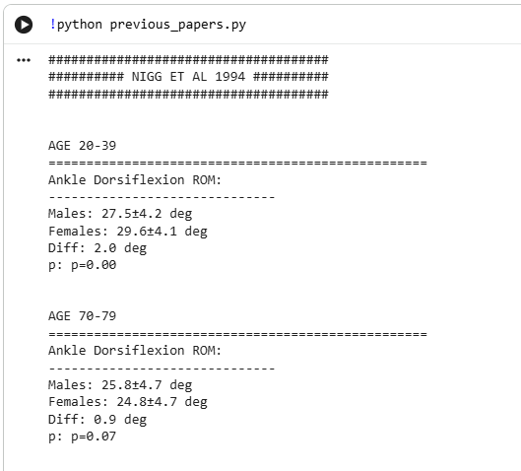
Reproduced Results III Literature Findings with Synthetic Data
Takeaway: The reproduced analyses support the paper’s claim that Multi-cGAN can recover meaningful relationships between gait parameters and subject/gait conditions. (Bicer et al., 2024; our reproduction notebook)

Slide 17
Reproduced Results IV Subject-Specific Predictions
Objective: To evaluate how well the trained models generate gait data for subjects excluded from training. (Bicer et al., 2024; our reproduction notebook)
Test setting: Three unseen subjects were used for subject-specific prediction. For each experimental trial, the models generated synthetic trials using the subject/gait conditions.
Best overall model: The WS-cGAN showed the best overall prediction performance for unseen test data.
Reproduced kinematics performance: WS-cGAN achieved the lowest overall IK error: IK RMSE = 4.7 ± 1.3°, R = 0.77 ± 0.09.
Sagittal-plane kinematics: WS-cGAN also performed best for sagittal-plane joint angles: RMSE = 6.1 ± 2.1°, R = 0.93 ± 0.07.
Ground reaction forces: WS-cGAN showed strong GRF agreement: GRF RMSE = 0.06 ± 0.03 BW, R = 0.81 ± 0.10. Multi-cGAN had the lowest GRF RMSE, 0.04 ± 0.01 BW, but lower correlation.

Slide 18
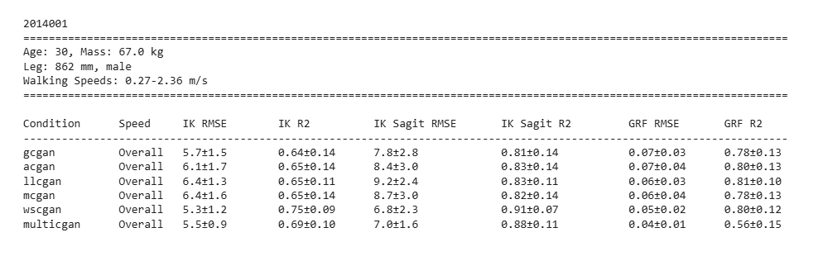
Reproduced Results IV Subject-Specific Predictions
Takeaway: Walking speed was the most informative single condition for predicting unseen gait data. (Bicer et al., 2024; our reproduction notebook)

Slide 19
Reproduced Results V Dynamic Consistency Analysis
Objective: To assess whether generated gait trials remain biomechanically plausible when processed through inverse dynamics. (Bicer et al., 2024; our reproduction notebook)
What was evaluated: The analysis compared residual pelvis forces and moments between experimental and synthetic trials.
Why it matters: Realistic-looking gait curves are not enough; synthetic mocap data should also preserve physically plausible movement dynamics.
WS-cGAN results: WS-cGAN showed relatively low differences for several pelvis moments before toe-off, but force-related measures were more variable.
Multi-cGAN results: Multi-cGAN also preserved several dynamic patterns, but some residual forces and moments still differed across the gait cycle.
Important limitation: The original paper notes that not every synthetic trial is guaranteed to be dynamically consistent, because the approach is data-driven rather than physics-constrained.

Slide 20
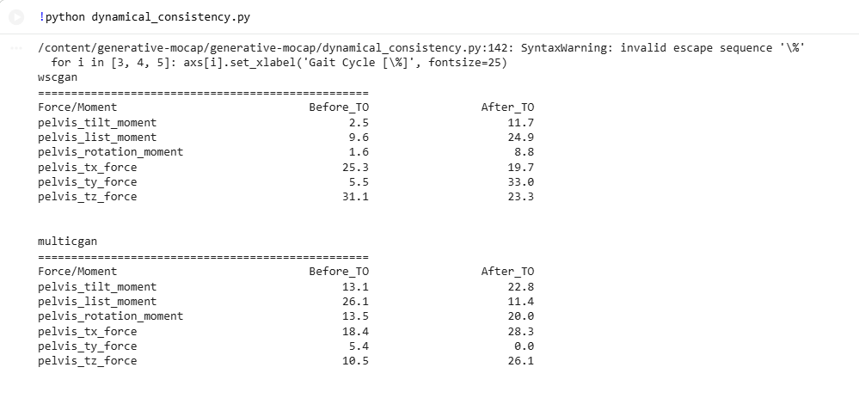
Reproduced Results V Dynamic Consistency Analysis
Takeaway: The dynamic consistency analysis partially supports the biomechanical plausibility of generated data, but also shows that synthetic trials still require physics-based validation. (Bicer et al., 2024; our reproduction notebook)

Slide 21
Discussion
1. Condition-controlled generation worked cGANs produced synthetic gait data guided by subject and gait characteristics.
2. Multi-cGAN is useful for controlled datasets It performed especially well when multiple conditions were constrained together.
3. Walking speed was the strongest single condition WS-cGAN performed best for unseen subject prediction.
Implication: The approach moves synthetic mocap from simple augmentation toward controllable dataset generation.

Slide 22
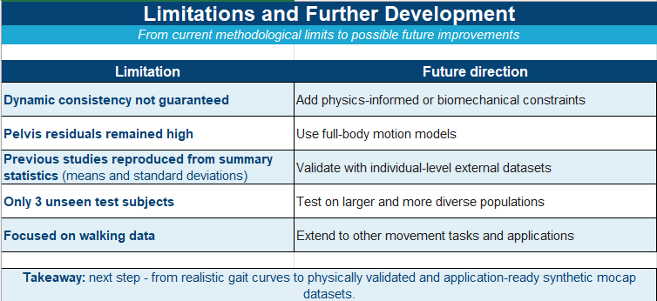
Limitations & Further Development

Slide 23
Conclusion
This reproduction supports the main conclusion of Bicer et al. (2024): cGANs can generate realistic synthetic walking mocap data controlled by subject and gait characteristics.
cGANs make synthetic mocap generation controllable using conditions such as age, sex, mass, leg length, and walking speed.
The reproduced workflow recovered the main result patterns reported in the original paper across dataset comparison, walking-speed analysis, literature findings, and unseen-subject prediction.
Walking speed was especially important for generating realistic unseen-subject gait data.
Synthetic mocap is promising, but not a replacement for real data because biomechanical consistency still needs validation.
Final takeaway: Condition-controlled synthetic mocap can support larger, more shareable, and more flexible human movement datasets.

Slide 24
References
Bicer, M., Phillips, A. T. M., Melis, A., McGregor, A. H., & Modenese, L. (2022). Generative deep learning applied to biomechanics: A new augmentation technique for motion capture datasets. Journal of Biomechanics, 144, 111301.
Bicer, M., Phillips, A. T. M., Melis, A., McGregor, A. H., & Modenese, L. (2024). Generative adversarial networks to create synthetic motion capture datasets including subject and gait characteristics. Journal of Biomechanics, 177, 112358.
Bicer, M. (2024). generative-mocap [Source code]. GitHub. https://github.com/metinbicer/generative-mocap
Bruening, D. A., Frimenko, R. E., Goodyear, C. D., Bowden, D. R., & Fullenkamp, A. M. (2015). Sex differences in whole body gait kinematics at preferred speeds. Gait & Posture, 41, 540–545.
Goodfellow, I., Pouget-Abadie, J., Mirza, M., Xu, B., Warde-Farley, D., Ozair, S., Courville, A., & Bengio, Y. (2014). Generative adversarial nets. Advances in Neural Information Processing Systems, 2672–2680.
Halilaj, E., Rajagopal, A., Fiterau, M., Hicks, J. L., Hastie, T. J., & Delp, S. L. (2018). Machine learning in human movement biomechanics: Best practices, common pitfalls, and new opportunities. Journal of Biomechanics, 81, 1–11.
Knudson, D. (2017). Confidence crisis of results in biomechanics research. Sports Biomechanics, 16, 425–433.
Mirza, M., & Osindero, S. (2014). Conditional generative adversarial nets. arXiv preprint arXiv:1411.1784.
Mundt, M., Koeppe, A., David, S., Witter, T., Bamer, F., Potthast, W., & Markert, B. (2020). Estimation of gait mechanics based on simulated and measured IMU data using an artificial neural network. Frontiers in Bioengineering and Biotechnology, 8, 41.
Nigg, B., Fisher, V., & Ronsky, J. (1994). Gait characteristics as a function of age and gender. Gait & Posture, 2, 213–220.
Raissi, M., Perdikaris, P., & Karniadakis, G. E. (2017). Physics informed deep learning: Data-driven solutions of nonlinear partial differential equations. arXiv preprint arXiv:1711.10561.
Robinson, M. A., Vanrenterghem, J., & Pataky, T. C. (2021). Sample size estimation for biomechanical waveforms: Current practice, recommendations and a comparison to discrete power analysis. Journal of Biomechanics, 122, 110451.
Ryasnova, E. (2026). Reproduction notebook for “Generative adversarial networks to create synthetic motion capture datasets including subject and gait characteristics” [Unpublished course notebook].
Schreiber, C., & Moissenet, F. (2019). A multimodal dataset of human gait at different walking speeds established on injury-free adult participants. Scientific Data, 6, 111.
Sharifi Renani, M., Eustace, A. M., Myers, C. A., & Clary, C. W. (2021). The use of synthetic IMU signals in the training of deep learning models significantly improves the accuracy of joint kinematic predictions. Sensors, 21, 5876.
Weinhandl, J. T., Irmischer, B. S., & Sievert, Z. A. (2017). Effects of gait speed of femoroacetabular joint forces. Applied Bionics and Biomechanics, 1–7.

Slide 25
Thank you !

